Slide 1


Organizational Behavior
(MGT-502)
Lecture-21

Slide 2
Summary of
Lecture-20

Slide 3
The Communication Process
Encoding
Channel
Decoding
Message
Message
Source
Receiver
Feedback

Slide 4
Nonverbal Communication
Body Motions
Body Language
Facial Expressions
Tone of Voice
Paralinguistics
Pacing and Pitch

Slide 5
Barriers to Effective Communication

Slide 6
Directions of Communications

Slide 7
Today’s Topics

Slide 8
Communication Principles
Communication has purpose
Communication is continuous
Communication messages vary in conscious encoding

Slide 9
Communication Principles continued
Communication is relational
Communication is culturally bound
Communication has ethical implications
Communication is learned

Slide 10

Functions of Communication
Control
Motivation
Information
Emotional
Expression

Slide 11
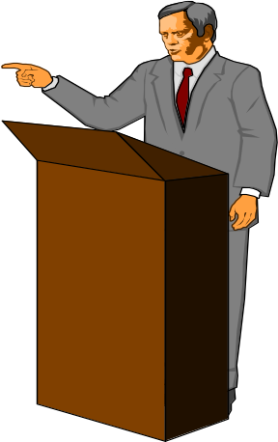

The Communication Process
Intended
Message
(Encoded)
Perceived
Meaning
(Decoded)
Noise
Physical Distractions
Semantic Problem
Cultural Differences
Lack of Feedback
Status Effects

Slide 12
Basic Interpersonal Communication Model
/
/
/
/
/
/
/
/
/
/
/
/
/
/
/
/
/
/
/
/
/
/
/
/
/
/
/
/
/
/
/
/
/
/
/
/
Event
X
Communicator
Receiver
Message
Context
Affect
Perceptual screens
Perceptual screens
Influence message quality, accuracy, clarity
Include age, gender, values, beliefs, culture, experiences, needs
Notes:
3

Slide 13
Interpersonal Communication
Oral Communication
  Advantages: Speed and feedback.
  Disadvantage: Distortion of the message.
Written Communication
  Advantages: Tangible and verifiable.
  Disadvantages: Time consuming and lacks feedback.
Nonverbal Communication
  Advantages: Supports other communications and provides observable expression of emotions and feelings.
  Disadvantage: Misperception of body language or gestures can influence receiver’s interpretation of message.

Slide 14
The Contribution of Communication Activities to Real Managers’ Effectiveness
Networking
Routine
communication
11%
Traditional
management
44%
19%
26%
Human Resource
Management

Slide 15
Upward
Direction of
Communication
Downward
Lateral
Notes:
7

Slide 16
Communication
Networks
Formal
Informal
Vertical
Follows authority
Task-related
Multidirectional
Skips authority
Social-related

Slide 17
Common Small-Group Networks
Chain
Wheel
All-Channel
Notes:
6

Slide 18
Small Group Network Effectiveness
    Networks
Criteria Chain Wheel All-Channel
Speed Moderate Fast Fast
Accuracy High High Moderate
Emergence of Moderate High None
Leader
Member Moderate Low High
Satisfaction
Notes:
8

Slide 19
The Grapevine
Control
Reliability
Self-
Interests

Slide 20
Barriers to Communication
Perceptual and Attributional Biases
Interpersonal Relationships
Top Management’s Role
Gender Differences in Communication
Physical Distance
Organizational Structure

Slide 21
What Will Your Audience Remember?
More
How Much is
Remembered
As time passes, your audience remembers less.
Less
How Much Time Passes
More

Slide 22
Electronic Communications
Work space
Work life and personal life
Organizational boundaries
Time constraints
Geographical constraints
Interpersonal contact

Slide 23
Technology and Communication
Electronic Mail
The Internet
Notes:
14

Slide 24
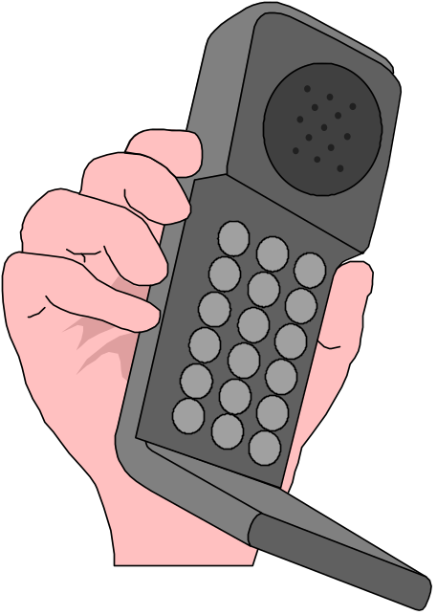
Computer-Mediated Communication
Informational databases
Electronic mail systems
Voice mail systems
Fax machine systems
Cellular phone systems
Notes:
22

Slide 25
How Does CMC Affect Communication?
Fast, immediate access to information
Immediate access to people in power
Instant information exchange across distance
Makes schedules & office hours irrelevant
May equalize group power
May equalize group participation
Notes:
23

Slide 26
How Does CMC Affect Communication?
Communication can become more impersonal--interaction with a machine
Interpersonal skills may diminish--less tact, less graciousness
Non-verbal cues lacking
Alters social context
Easy to become overwhelmed with information
Notes:
24

Slide 27

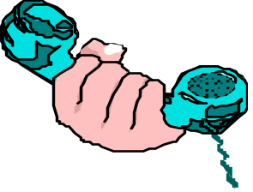


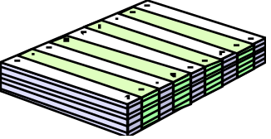
Hierarchy of Channel Richness
Channel
richness
Type of
message
Information
medium
Richest
Nonroutine,
ambiguous
Face to face
talk
Telephone
Computer
Memos,
letters
Flyers, bulletins
general reports
Leanest
Routine,
clear
Notes:
10/28/01
5

Slide 28
Gender Communication Differences
Men
Women
Gives advice quickly and directly
Gives advice indirectly and reluctantly
Avoids asking for information
Frequently asks for information
Less sensitive to nonverbal cues
More sensitive to nonverbal cues

Slide 29
Guidelines for Effective Speaking
Determine the purpose of your communication
Consider issues of time and space
Adapt to your listeners
Use appropriate vocabulary
Practice voice control
Use appropriate gestures
Organize your presentation

Slide 30
Guidelines for Active Listening
Control the physical environment
Be alert
Be mentally prepared
Be emotionally prepared
Be attentive
Read nonverbal cues
Distinguish among facts, inferences, and value judgments
Offer and Solicit Feedback

Slide 31
Improving Communication in Organizations

Slide 32

Utilizing Feedback
Following Up
Repetition
Empathy
Regulating Information Flow

Slide 33

Effective Listening
Effective Timing
Simplifying Language
Using the Grapevine

Slide 34

Communications and HRM

Slide 35
How do you find out about what happens at work?
BULLETIN BOARD
NEWSLETTER
GOSSIP
?????

Slide 36

Employee Handbook Purpose

Slide 37
Employee
  Information central source
  Commitment, security
  Direction
Employer
  Committed workforce
  Recruit
  Educate, inform, and guide employees

Slide 38
Helps employees learn about company at their own pace
Provides references regarding policies, rules, and benefits
Ensures HRM policies will be consistently applied
Creates sense of security and commitment for employees
Provides information to recruits
May be interpreted as implied contract
Should be updated continually

Slide 39

To Achieve that….
AN EMPLOYEE HANDBOOK SHOULD BE
Well organized
Clearly written
Legally limited

Slide 40
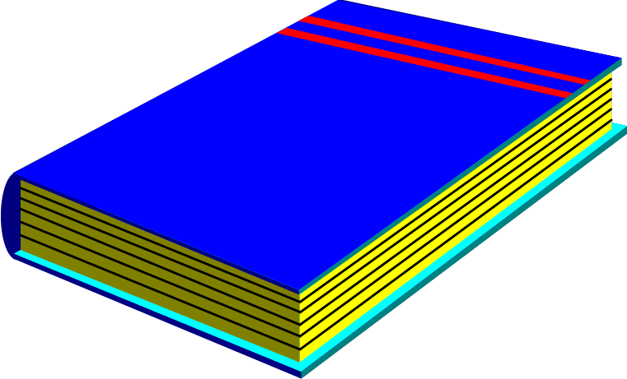
Employee Handbook Contents

Slide 41
Introductory comments
What you should know
Your benefits
Your responsibilities and safety procedures

Slide 42

Introductory Comments

Slide 43
Greetings
Welcome
Valuable to the company
Tone setting, culture statement
Performance, role expectations

Slide 44

What You Should Know

Slide 45
Rules and policies
  Attendance, work hours
  Lunch hours
  Lay off practices
  Performance appraisal issues

Slide 46

Your Benefits

Slide 47
Membership-based
Keep morale high
Costs
Eligibility

Slide 48
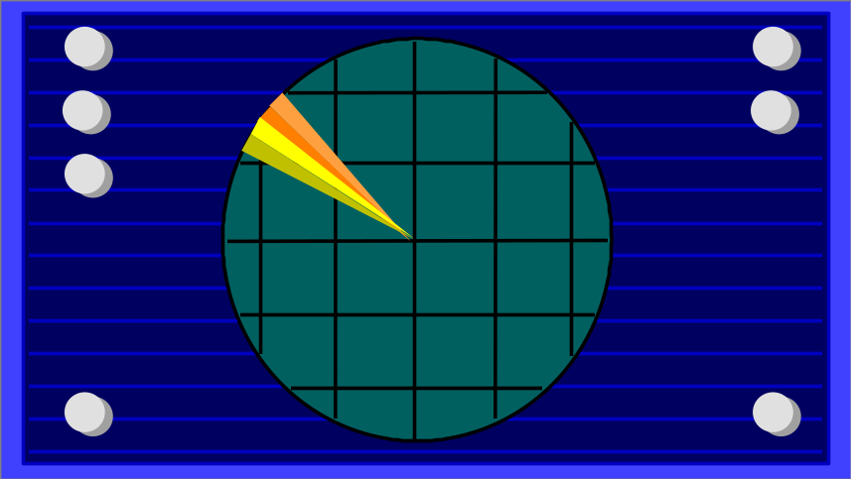
Responsibilities and Procedures

Slide 49
Safety
Personal conduct
Reporting accidents
Compliance requirements

Slide 50

Communication Methods

Slide 51
Employee handbook
Bulletin board
Company newsletter
Company-wide meetings
Digital Media
Etc.

Slide 52
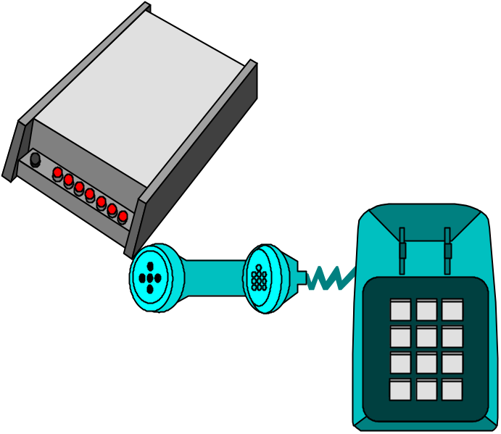
For Offsite Employees
  Facsimile machines
  Emails
  Internet
  Phone

Slide 53
HRM Communications Programs

Slide 54
Keep employees informed
Convey organization’s concern for employees
Build trust and openness
Monitor employee concerns

Slide 55
Purpose of HRM Communications

Slide 56
Keep employees informed
Tool to bring about positive change
Influence culture

Slide 57



External Organizational
Communication
Public
Relations
Marketing and
Advertising
Surveys
Lobbying
Notes:
8

Slide 58
Ethics in Communication
Practicing Honesty
Refraining From Doing Harm
Being Fair and Just
Notes:
15

Slide 59

Let’s stop it here

Slide 60
Summary

Slide 61
Functions of Communication
Control
Motivation
Information
Emotional
Expression

Slide 62
What Will Your Audience Remember?
More
How Much is
Remembered
As time passes, your audience remembers less.
Less
How Much Time Passes
More

Slide 63
Improving Communication in Organizations

Slide 64
Next….

Slide 65
Organizational Behavior
(MGT-502)
Lecture-21

